Slide 1
Measuring the bikeability in Amsterdam across PC4 areas
Case Study - Final Presentation
Group - 5
Sajad AHMADI Jozdani 5328381
Erdem KOCER 9424644
Shehab Al-MASRI 4338707

Slide 2
Content
Introduction - research question
Literature review
Methodology
Results
Conclusion

Slide 3
Introduction
Biking is gaining significance due to the rising interest in bicycle usage
Measuring the bikeability is crucial for assessing a city's cycling infrastructure
There are no one-size-fits-all equation

Slide 4
Research Question
What is the bikeability of Amsterdam across PC4 areas in terms of grenness, biking infrastructure, and parking facilities?

Slide 5
Literature Review
Eye-level greenness significantly influences cycling frequency, with visible greenery within 500m to 1500m boosting cycling and integrating it with public transport - Wanga et al. (2020)
Design features such as quick routes and dedicated bike lanes are crucial for encouraging cycling; wider and protected bike lanes increase active transportation, suggesting that infrastructure development is key for cyclist and pedestrian quality - Silva et al. (2011) and Aziz et al. (2018)
Efficient bike parking management and integration into city planning are essential for improving the bikeability experience and supporting sustainable mobility - Van der Spek and Scheltema (2015) and Schmid-Querg et al. (2021)

Slide 6
Methodology
Data: Amsterdam.nl and CyclOSM
Geopandas : Data cleaning and spatial operations
QGIS: Visualisation
Folium: Visualisation in notebook

Slide 7
Methodology: Greenness
Map algebra between PC4 and green areas
Map Algebra functions, Field Calculator
Polygon in Polygon overlay
Aggregation by PC4 area
Visualisation on QGIS

Slide 8
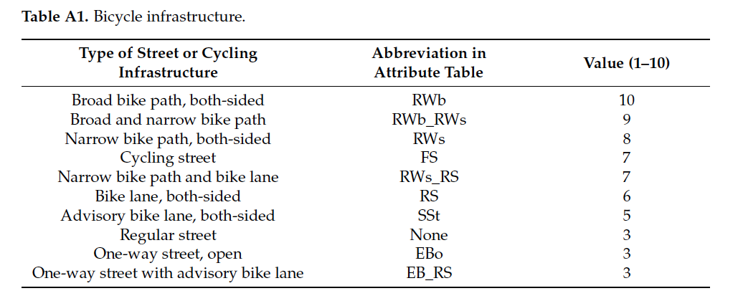
Methodology: Infrastructure Quality
Biking Network from Amsterdam.nl
Assigning quality scores to bike lane types (Schmid-Querg et al. (2021))
Map overlay, interaction with PC4 areas
Measured the weighted average of the quality score per PC4

Slide 9
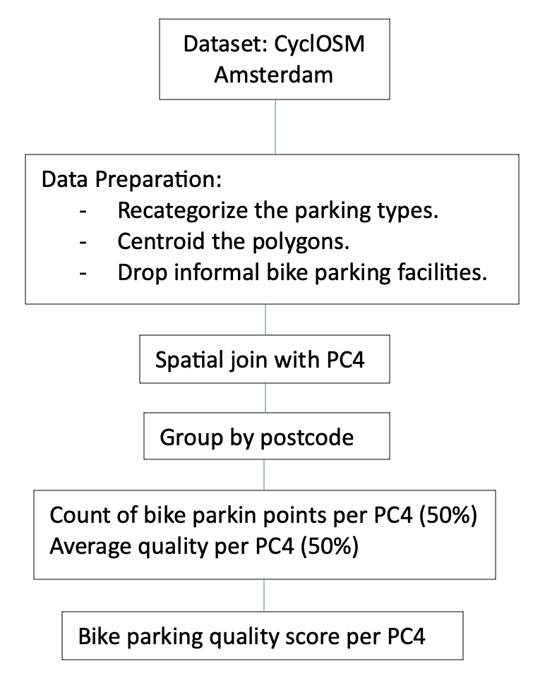
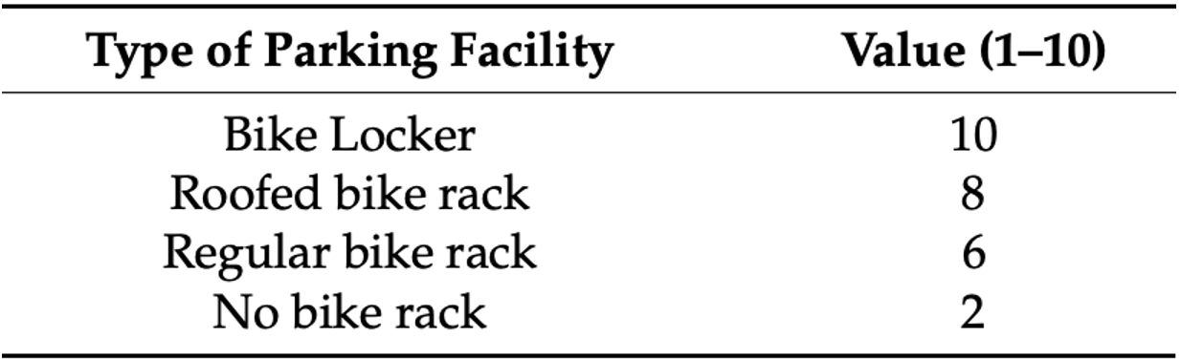
Methodology - Bike Parking Amenities
OpenStreetMap
Data cleaning and preparation
Bike parking amenities categories and weights (Schmid-Querg et al. (2021))
72 out of 85 PC4 areas
Spatial Join and group by PC4:
Count of nike parking points per PC4 (50%)
Average quality per PC4 (50%)

Slide 10
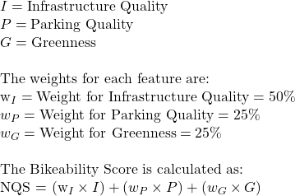
Methodology: Final Equation
Ref: Schmid-Querg et al. (2021)

Slide 11
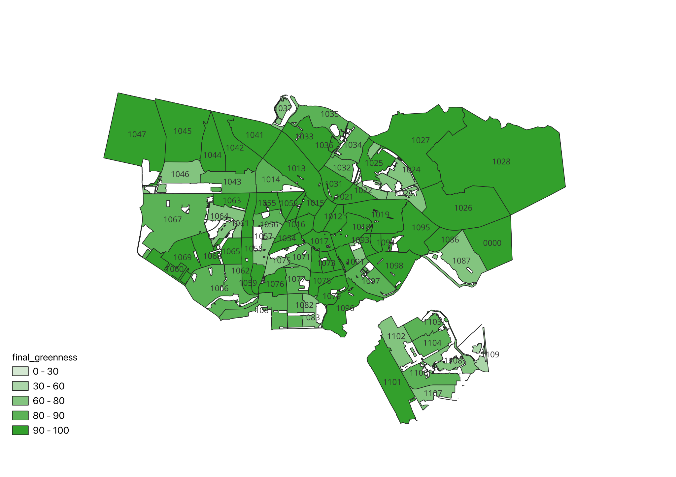
Results - Greenness

Slide 12
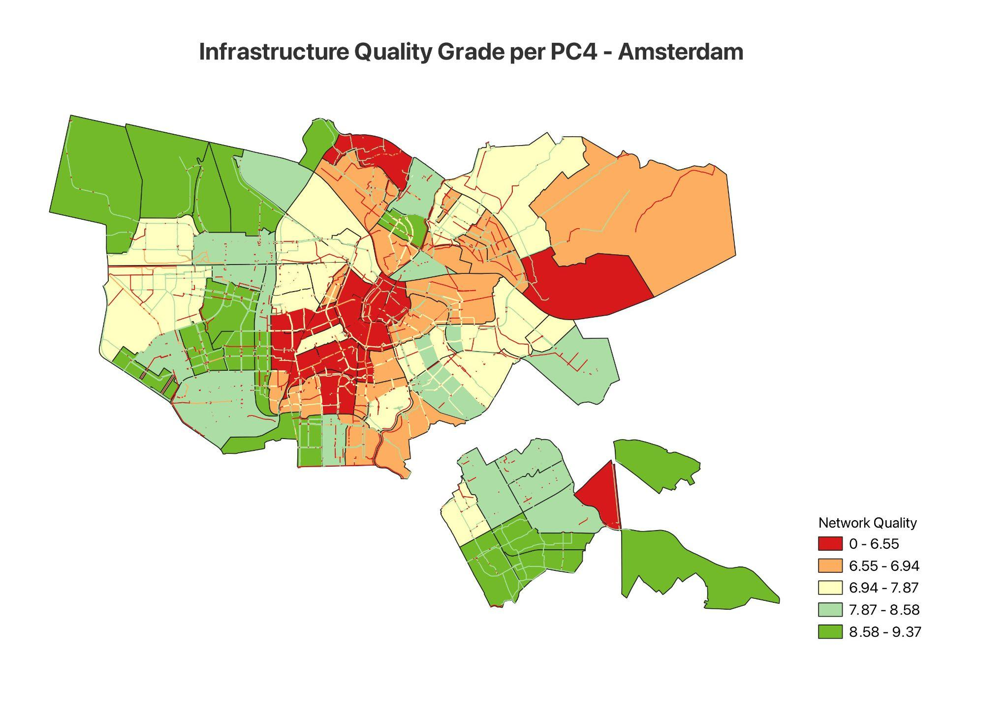
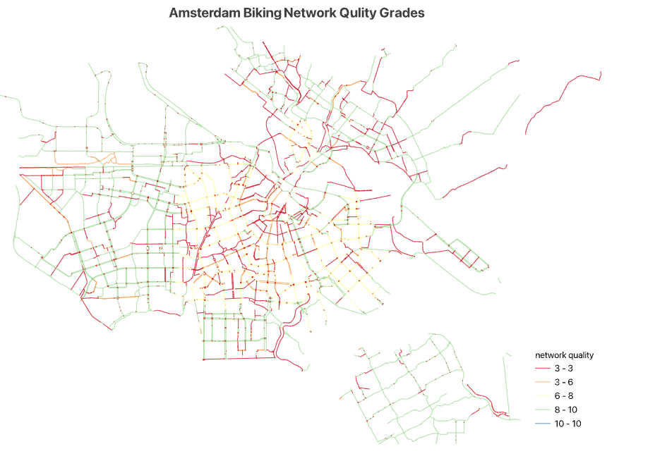
Results - Infrastructure Quality

Slide 13
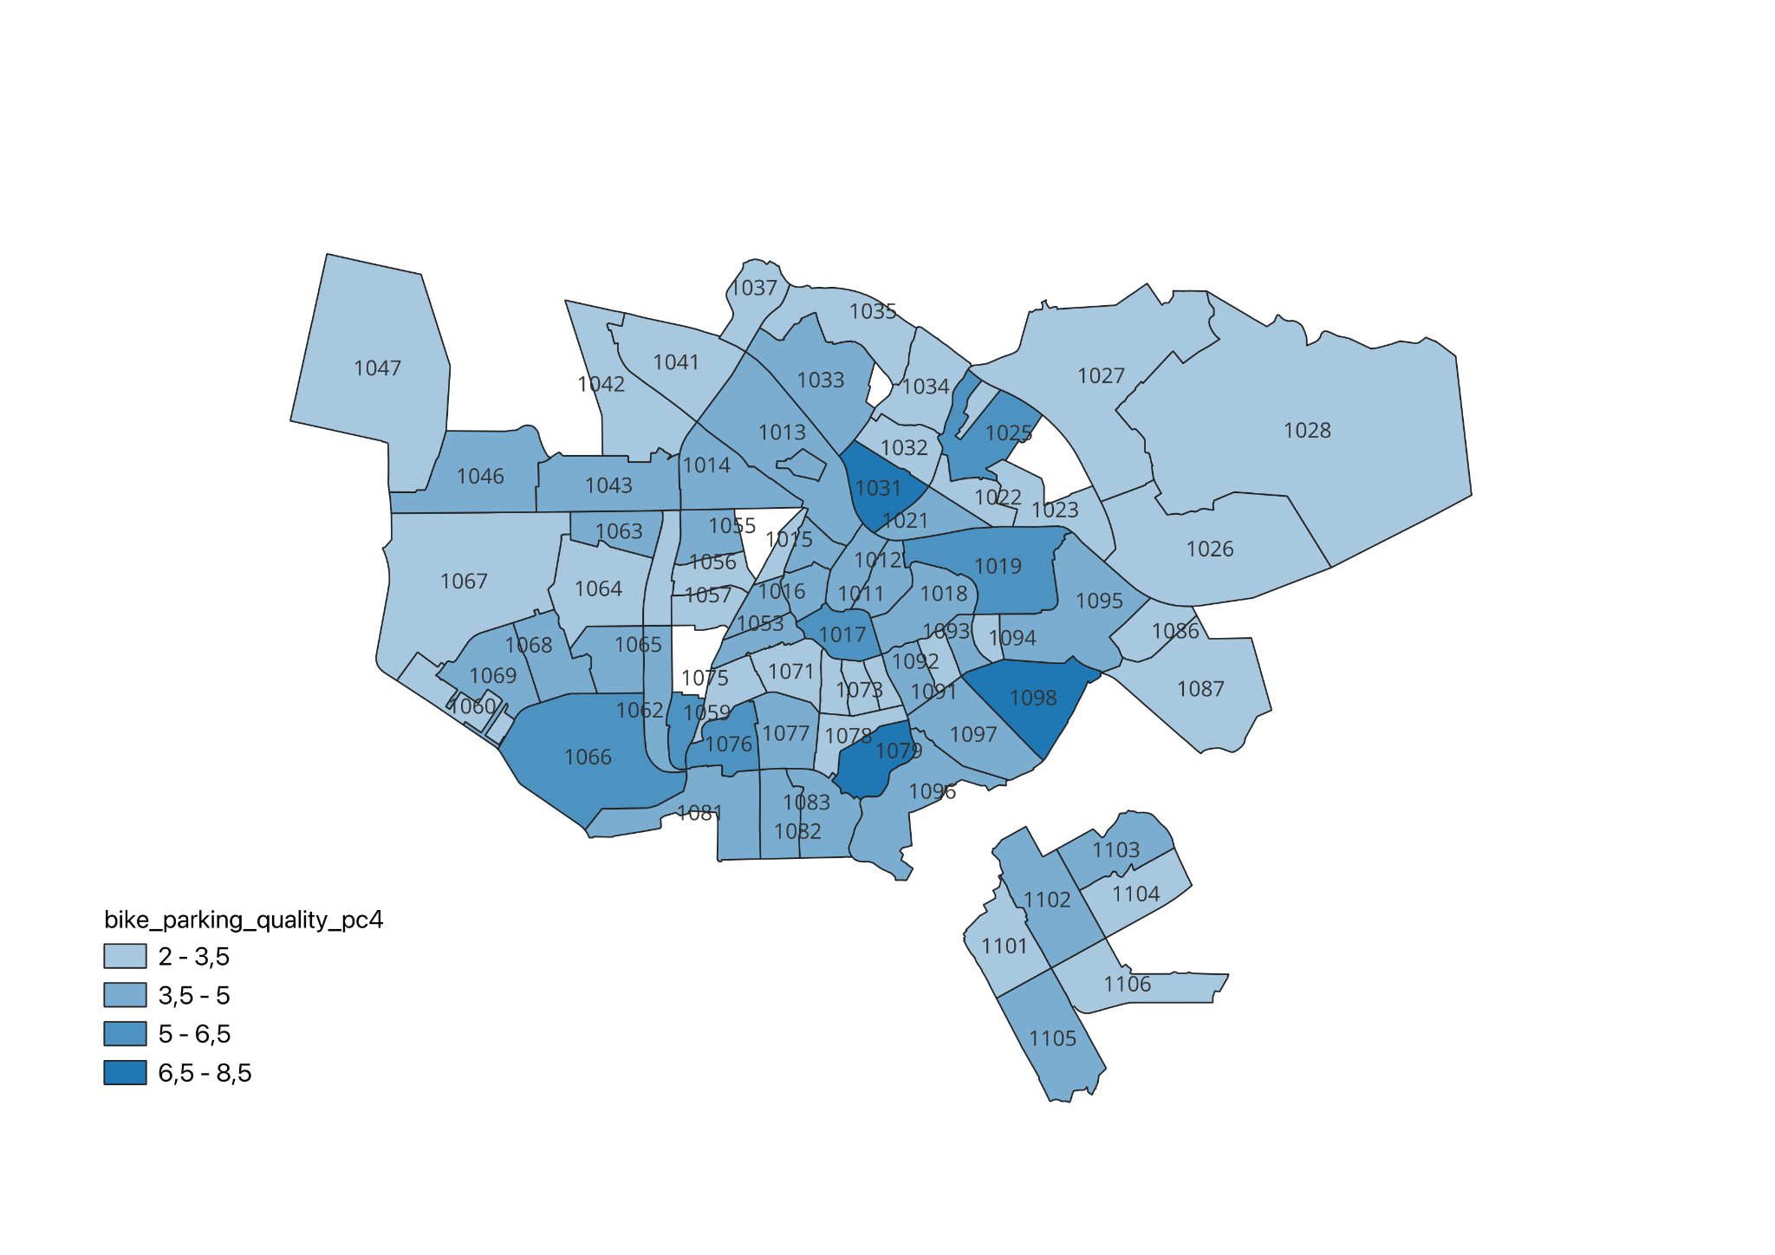
Results - Bike Parking Amenities

Slide 14
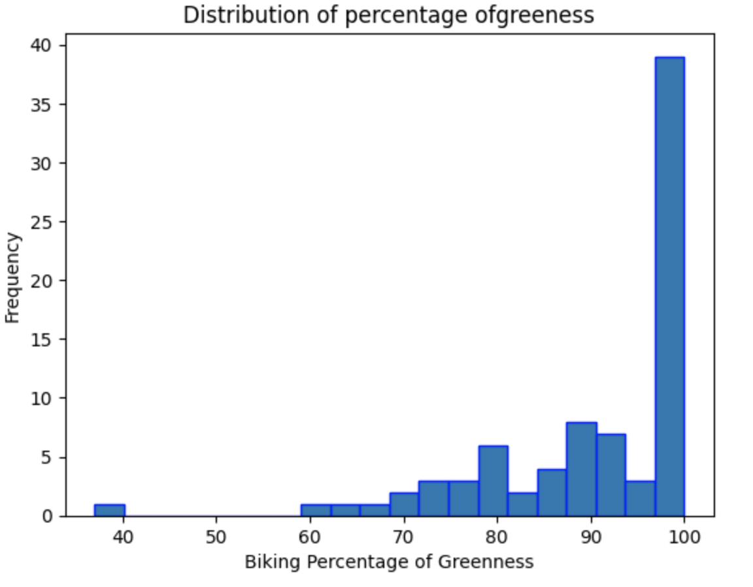
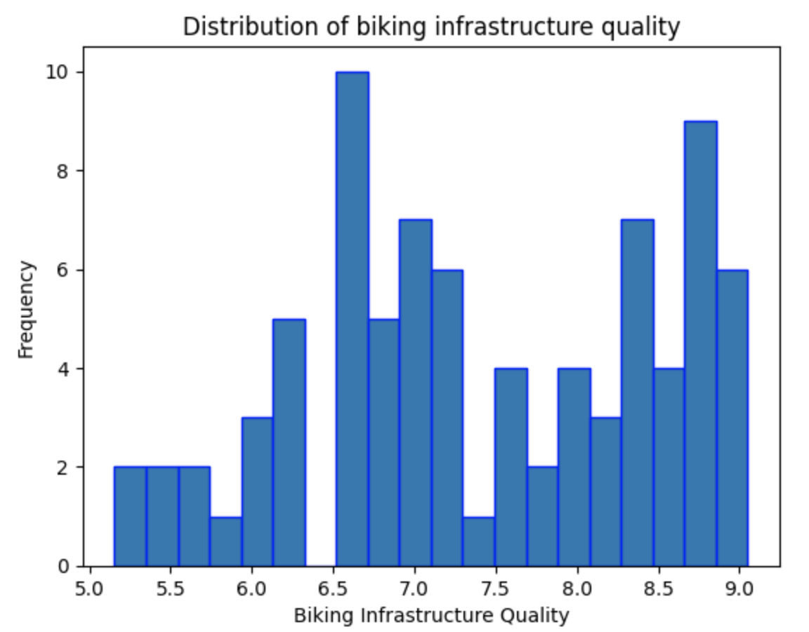
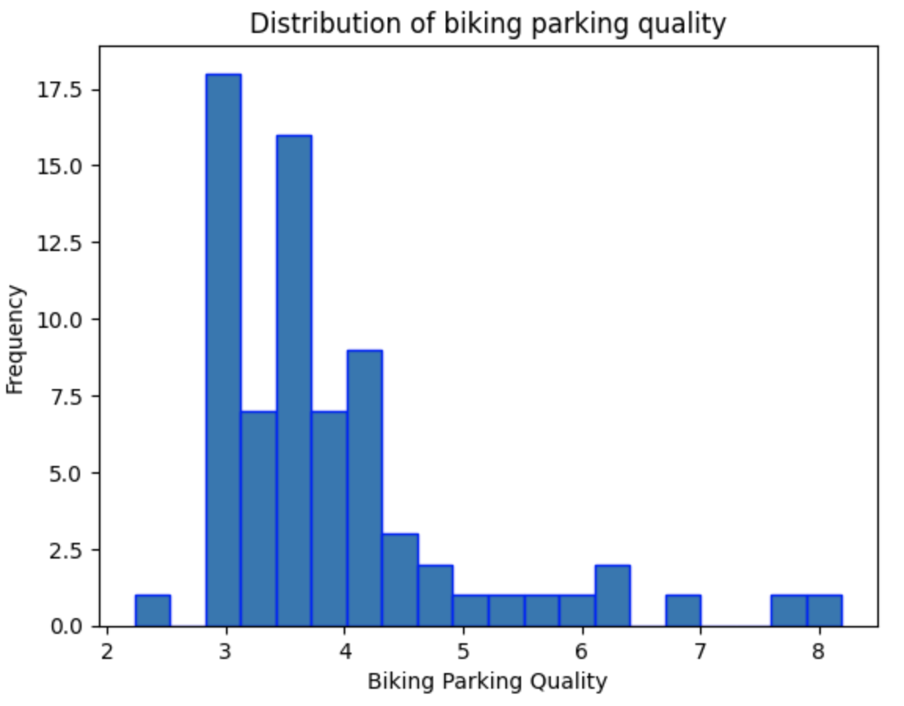
Results

Slide 15
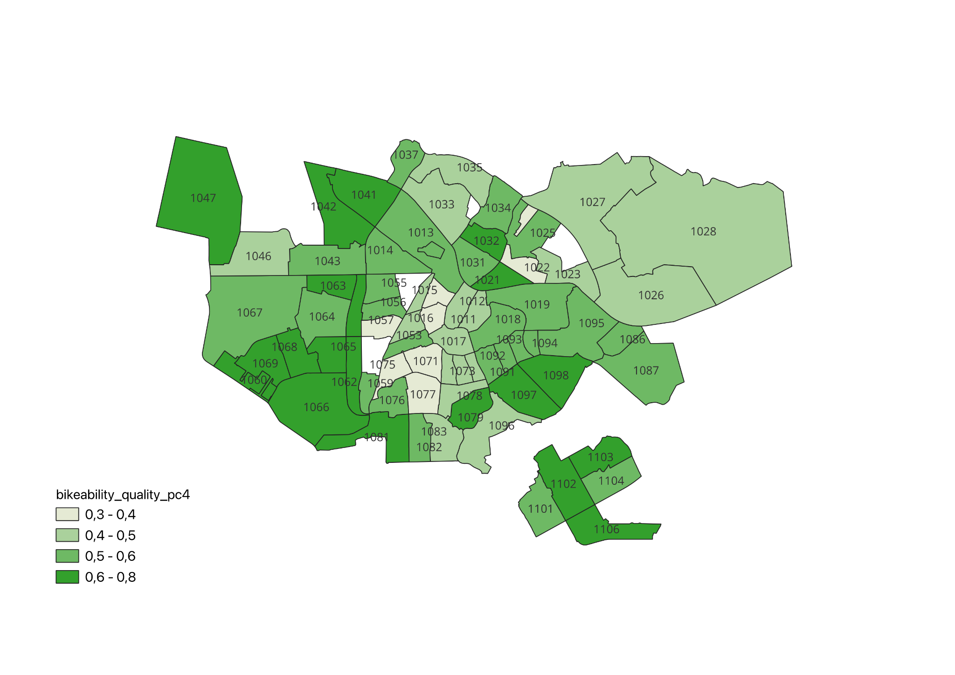
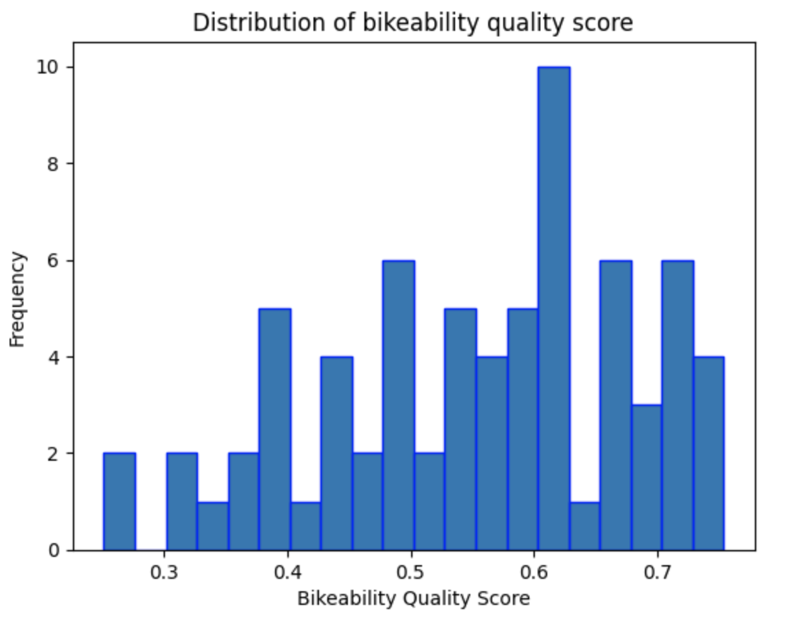
Results - Overall Quality

Slide 16
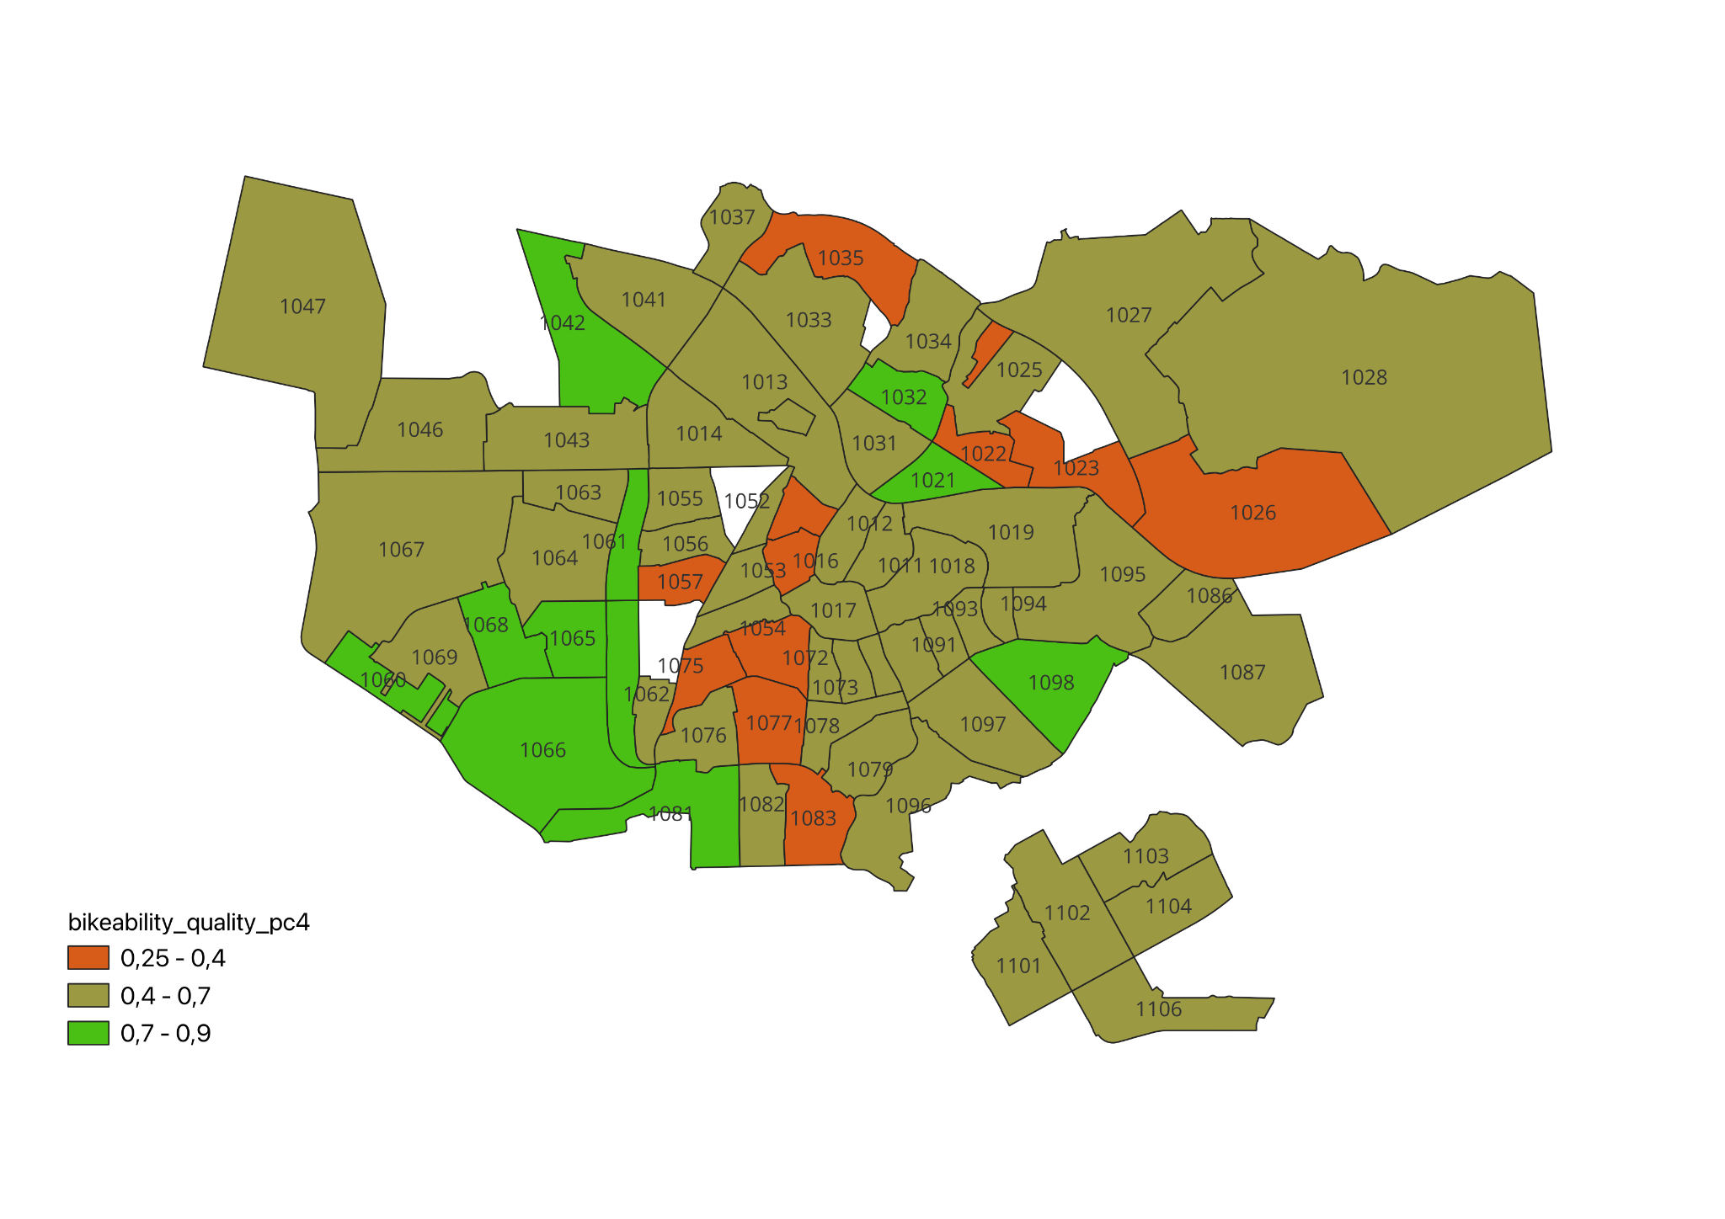
Results
Highest Quality | Score | Lowest Quality | Score
1066 1060 1032 | 0.75 0.75 0.73 | 1071 1075 1057 | 0.25 0.26 0.31

Slide 17
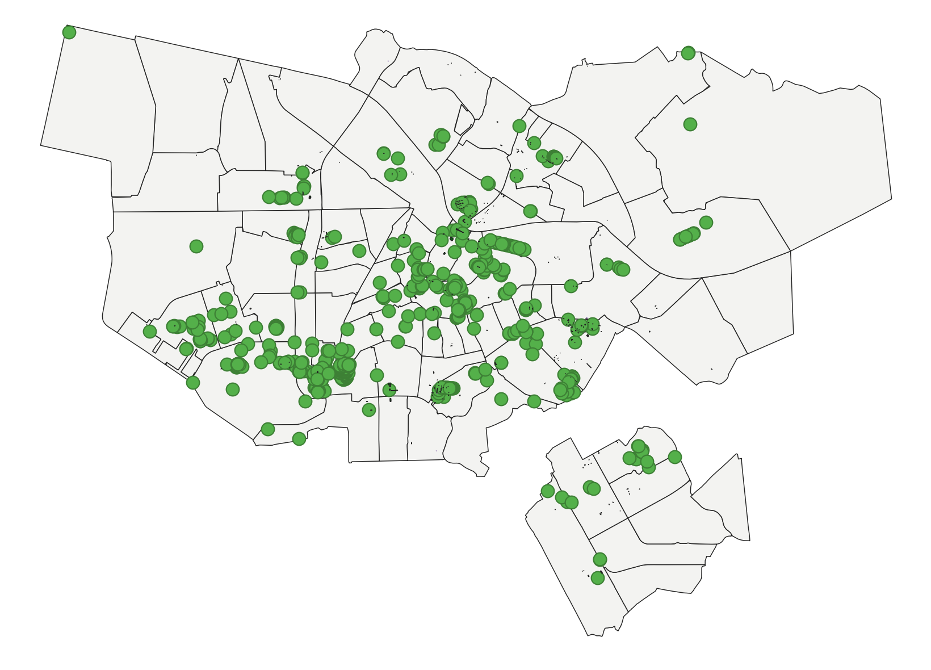
Conclusion & Discussion
Overall overview the quality of greenness, biking infrastructure, and bike parking facilities
Calculated bikeability quality score for 71 out of 85 PC areas
Most PC4 areas show high greenness
Biking infrastructure quality is generally high
Bike parking amenities have low quality
Data Source Limitation: CyclOSM

Slide 18


Slide 19
References
Wang, R., Lu, Y., Wu, X., Liu, Y., & Yao, Y. (2020). Relationship between eye-level greenness and cycling frequency around metro stations in Shenzhen, China: A big data approach. Sustainable Cities and Society, 59, 102201. https://doi.org/10.1016/j.scs.2020.102201
Wahlgren, L., & Schantz, P. (2012). Exploring bikeability in a metropolitan setting: stimulating and hindering factors in commuting route environments. BMC Public Health, 12, 168. https://bmcpublichealth.biomedcentral.com/articles/10.1186/1471-2458-12-168
City of Amsterdam. (2024, January 30). Maps data. https://maps.amsterdam.nl/open_geodata
Gu, P., Han, Z., Cao, Z., Chen, Y., & Jiang, Y. (2018). Using open source data to measure street walkability and bikeability in China: A case of four cities. Transportation research record, 2672(31), 63-75.
McNeil, N. (2011). Bikeability and the 20-min neighborhood: How infrastructure and destinations influence bicycle accessibility. Transportation research record, 2247(1), 53-63.
Schmid-Querg, J., Keler, A., & Grigoropoulos, G. (2021). The Munich bikeability index: A practical approach for measuring urban bikeability. Sustainability, 13(1), 428.

